Slide 1
PINBALL VERSUS

Slide 2
OBJECTIVES
To familiarize with the Object-Oriented Programming (OOP) with respect to C++ language.
To be able to use various features of C++ language.
To be able to implement the knowledge gained through the lectures of our C++ lecturer into real life programming.
To develop a game using almost all the features of C++ and using graphics libraries such as SFML.
To develop the logic for good programming practice.
To learn to work in a group and other project management skills.

Slide 3
BACKGROUND
Pinball is a type of arcade game, in which points are scored by a player manipulating one or more steel balls on a play field inside a glass-covered cabinet called a pinball machine (or "pinball table").
A game ends after all the balls fall into the drain a certain number of times, which is avoided using flippers at bottom.

Slide 4
EXISTING SYSTEM
The version of the game that everyone has heard of is the space cadet version which was included in past versions of windows.
Many open source, modified and fancy pinball games are also available in internet.

Slide 5
INTRODUCTION: PINBALL VERSUS
Pinball Versus is the modified version of classic pinball game by using its core rules and features and also adding our own customizations for better gameplay and user experience.
It is a multiplayer game, which can be played in two different modes viz. highest scorer in two minutes to win, and player to score first 5 points to win .

Slide 6
IMPLEMENTATION
The game starts with basic menu to enter the game.
When the player chooses Play option, he/she enters into game mode selection menu.
Two options: Two minutes and Score 5 to win
Game starts
Game ends, and goes back to menu when any player scores 5 goals first, or after 2 minutes depending upon the game mode.

Slide 7
METHODOLOGY
This project has been designed using C++, and popular graphics library SFML in Visual Studio IDE.
Game’s major components:
Menu
Board and Assets
Ball Physics
Collision Detection
Flipper Physics
Game Updates and Game Modes
Sound Effects

Slide 8
HEADER FILES AND CLASS
Ball.h
Flipper.h
Vector.h
Menu.h
BumperObstacle.h
GameLoop.h
PowerUps.h

Slide 9
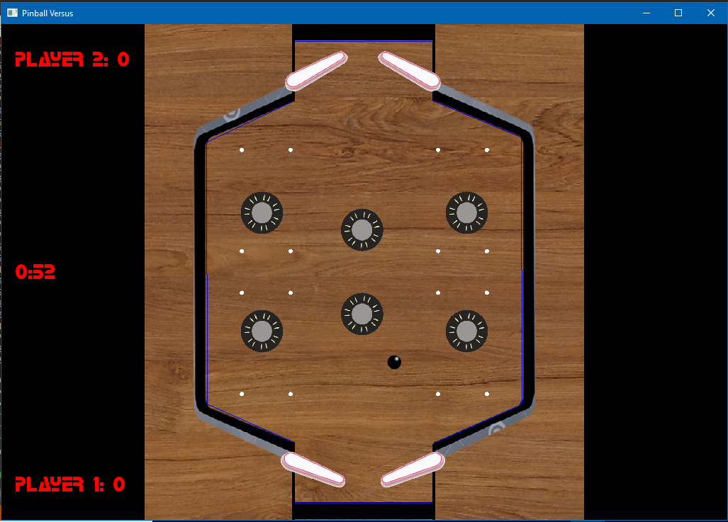
A Glimpse at the Resulting system

Slide 10
LIMITATION AND ENCHANCEMENT
Current project has only multiplayer option. Single player option can be added in future.
Similarly, the game can only be played between two human players, not with computer. This feature can also be added in future using Artificial Intelligence.
It is only a simple prototype, which can be enhanced by including tournament modes, including rewards, playing in different maps and so on.

Slide 11
CONCLUSION
We learned to manage and develop a real world project.
We also the learned about importance of team work, and learned how to work in a group.
We also got hands-on experience of using OOP concept to model real world objects like ball, board flipper, and how it makes large program management and maintenance easier.

Slide 12
Here goes our project Demo

